Slide 1

Search
o Command recognition
o Console UI implementation
o Command interpreter implementation
o Process representation
o Scheduler implementation
CSOPESY Major Output: Process Scheduler and CLI
Creating a process scheduler and CLI
RIZZA CHAN JERIMAYA FLORES HANEUL KIM JUSTIN SACDALAN
1
S22 S13 S22 S22

Slide 2
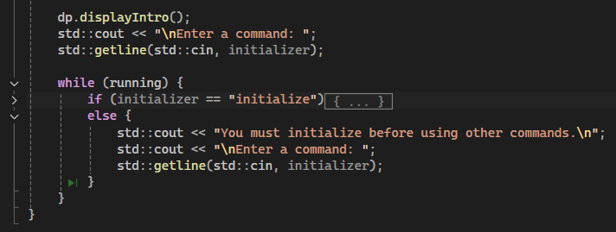
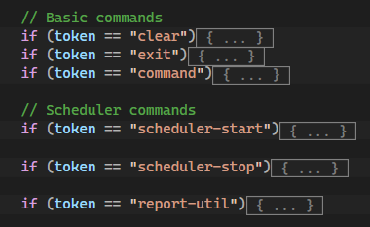
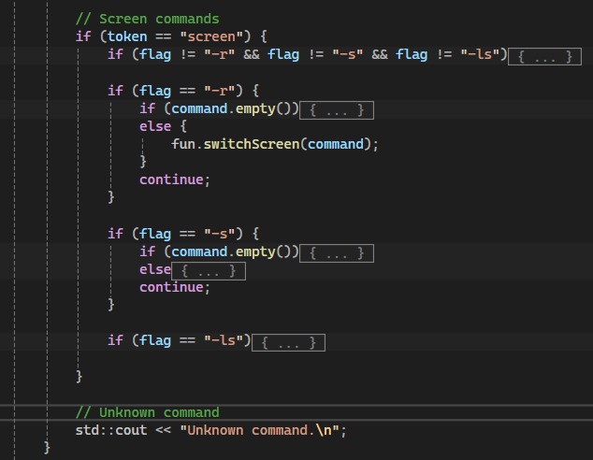

Command Recognition
In MainConsole.cpp → when the CLI is ran, it will only accept “initialize” as the recognizable command.
-----------------------------------------------------------------------------------------------------------------------------------------------------------------------------------------------------------------------------------------------------------------
In MainConsole.cpp → After initializing, the tokens and flags showed in the code snippets are the only accepted commands and prompting to user to use the commands listed when inputting a non-recognizable command.
2

Slide 3
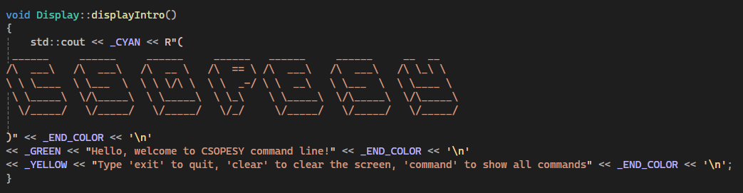
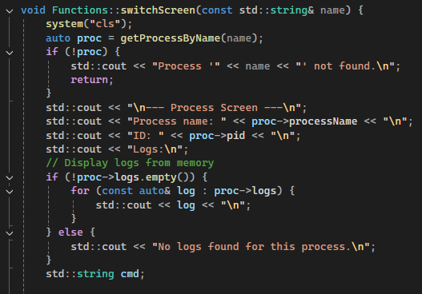
Console UI implementation
displayIntro → will be called by main after running to show the header and will be called subsequently after clears and when returning to main menu from a process screen
-----------------------------------------------------------------------------------------------------------------------------------------------------------------------------------------------------------------------------------------------------------------
switchScreen → will be called after creating a screen via screen -s or by screen -r. this function will draw the UI when inside a specified process.
3

Slide 4
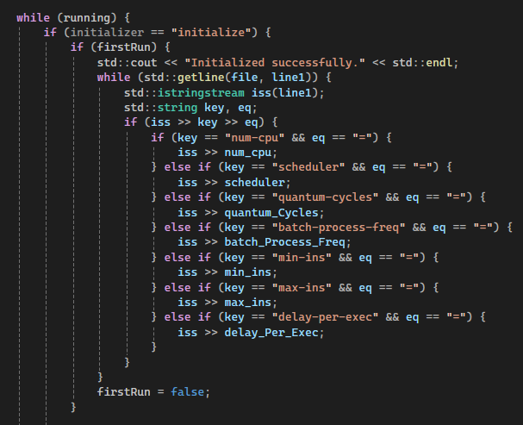
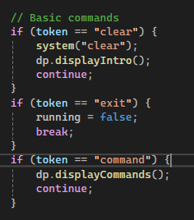
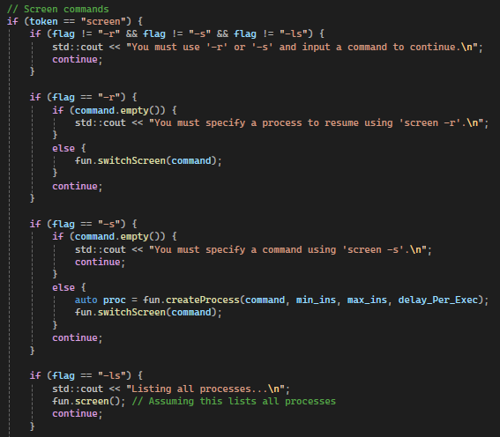
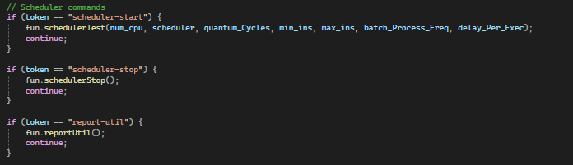
Command interpreter implementation
In MainConsole.cpp → After recognizing the command, calls the correct function to execute the recognized command
4

Slide 5
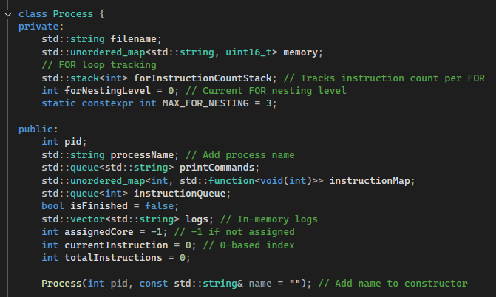
Process representation
In Process.h → Provides the variables each process object will have.
5

Slide 6
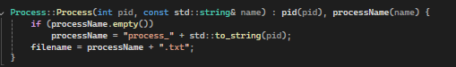
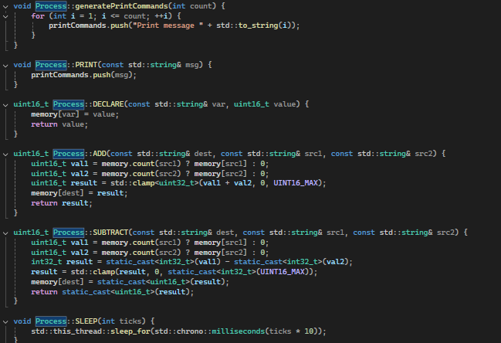
Process representation - Instructions
Creates the log file for the specified process
generates a print command
declare -> declares of a uint16 variable
Add → adds two variables obtained from declare or random number
subtract → Subtracts 2 variables similar in functionality with add
Sleep → sleeps the thread based on the ticks sent to it
6

Slide 7
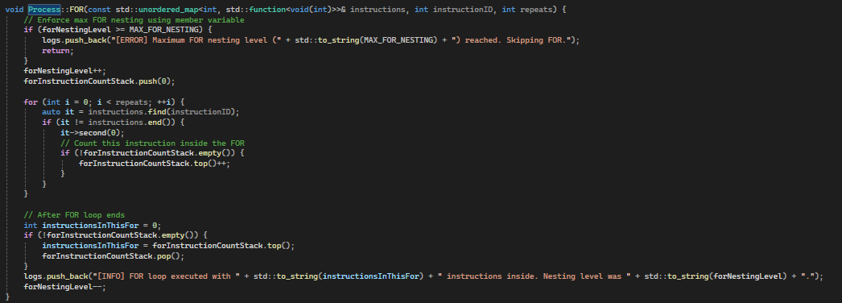
Process representation - Instructions
For → randomly selects the instruction to do as well as how many times it can do it this is inclusive of itself should the for loop repeat up to 3 times it will skip the instruction and randomize another instruction to do instead
7

Slide 8
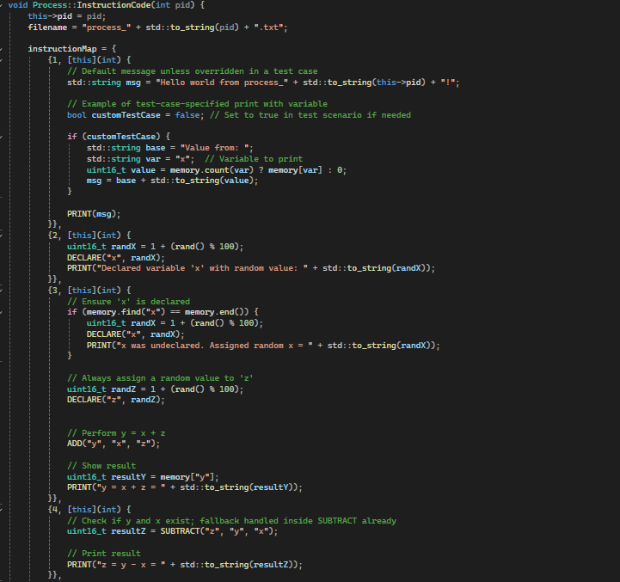
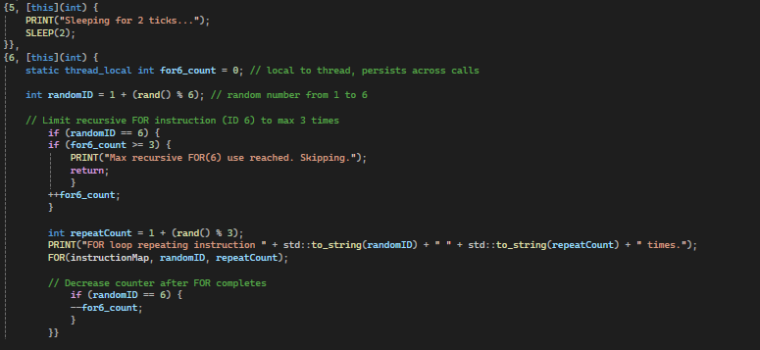
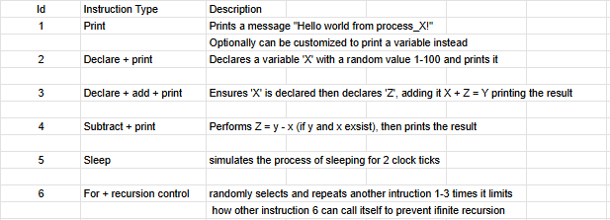
Process representation - Instructions
8

Slide 9
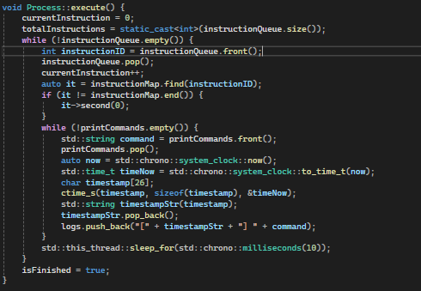
Process representation - Instructions
Initializes Execution Tracking, setting the currentinstructions to 0 and storing how many instructions will be executed in totalinstructions, Executing the m sequentially. while there are still instructions in the queue it will pop the next ID. Looks it up in instructionMap and then executes the associated function. It will then print the results into the logs with a timestamp. waiting 10ms per instruction to simulate time passing.
Once done it will mark the process as Finished and it the queue is empty isFinished is set to true
9

Slide 10
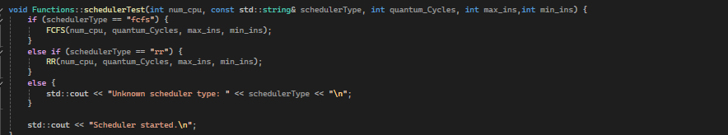
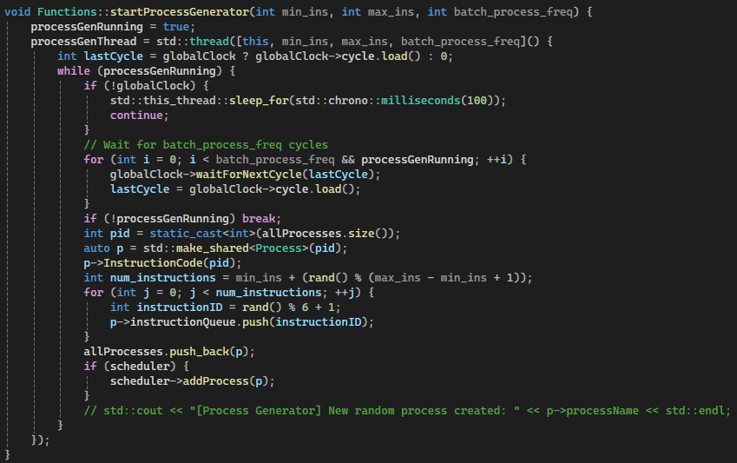
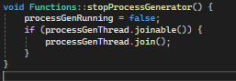
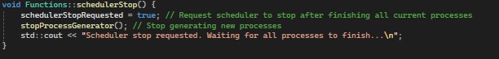
Scheduler implementation - Generic Functions
schedulerTest → starting function that will take in num_cpu, schedulerType, quantum_cycles, max_ins, min_ins and then based on the identified schedulerType will call the function that houses the logic for Round robin and First com First Serve implementations
-----------------------------------------------------------------------------------------------------------------------------------------------------------------------------------------------------------------------------------------------------------------
startProcessGenerator → Creates processes equal to the max_ins from the config file also uses a global clock cycle
stopProcessGenerator → stops the ProcessGenerator from creating more processes
-----------------------------------------------------------------------------------------------------------------------------------------------------------------------------------------------------------------------------------------------------------------
schedulerStop → sets values to stop the creation of processes
10

Slide 11
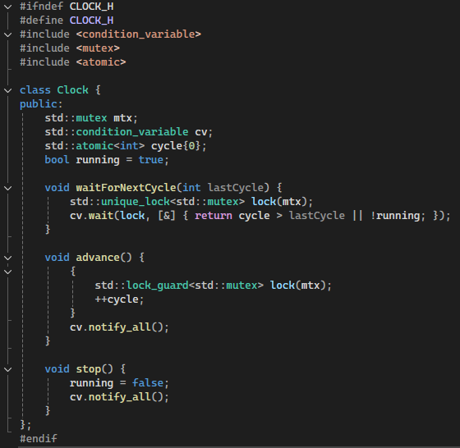
Clock implementation
Clock → creates a synchronized clock that will be used when there are multiple cores
• Process Generation: The process generator thread waits for a certain number of clock cycles before creating new processes, using waitForNextCycle.
• Synchronization: Any component that needs to perform actions in sync with the global clock can use waitForNextCycle to block until the next tick.
• Advancement: The clock is advanced in a dedicated thread, ensuring a consistent and global notion of time for all components.
11

Slide 12
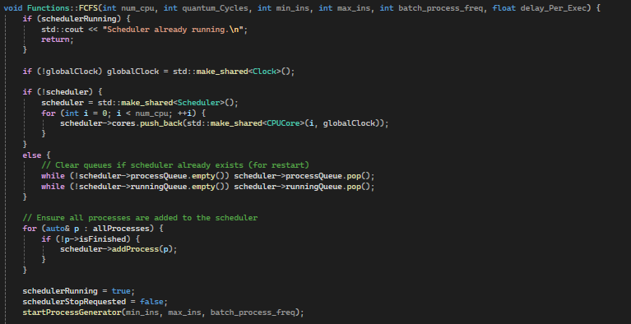
Scheduler implementation - FCFS
FCFS scheduler → this function first initializes the necessary components for the program. This includes:
a check if the scheduler is already running
creation/initialization of a globalClock
creation/initialization of CPU cores
loading of randomly generated processes
12

Slide 13
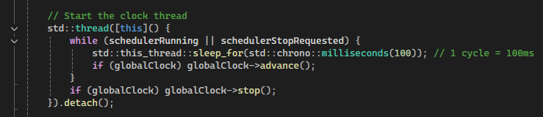
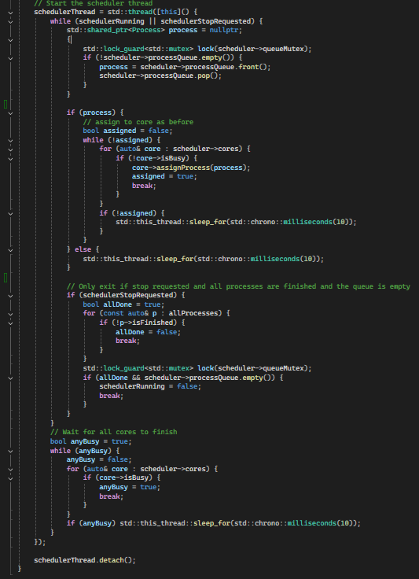
Scheduler implementation - FCFS
After initialization, the scheduler will proceed with starting the clock thread and syncing all created CPU Cores to the global clock.
The rest of the function illustrates the logic of a typical FCFS scheduling algorithm where:
Processes are assigned to an idle CPU core
Once in the ready queue they are executed in FIFO order
Keeps checking for any incoming processes and if the queue is empty or not before stopping (using ‘break’ to leave the scheduler loop)
13

Slide 14
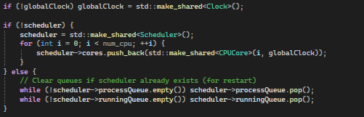
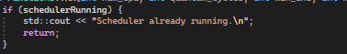
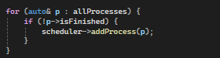
Scheduler implementation - Round Robin
Function signature
Runs on num_cpu cores
Assigns each process a time slice (quantum_Cycles)
Creates processes with min_ins to max_ins instructions
Generates new processes every batch_process_freq cycles
gets delay_per_Exec assigned to timePerCycleMs
Initialization of global clock, scheduler and core setup
---------------------------------------------------------------------------------------------------------------------------------
Stops the creation of another scheduler
Requeues unfinished process
14

Slide 15
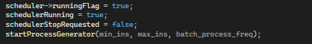
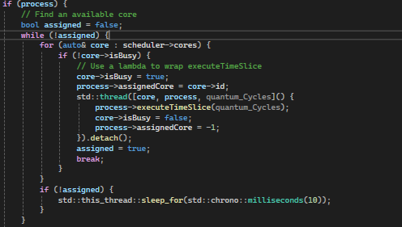
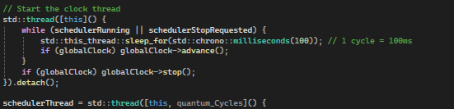
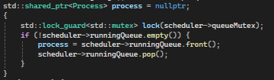
Scheduler implementation - Round Robin
sets scheduler’s running flags as well as creates processes based on max_ins and min_ins
---------------------------------------------------------------------------------------------------------------------------------
starts clock thread and scheduler threads
assigns processes to a free core. Once on is available it while execute its time slice before it is marked as free again
Dequeues a process to retrieve the next process
15

Slide 16
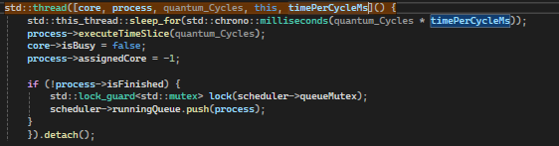
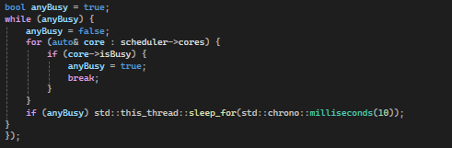
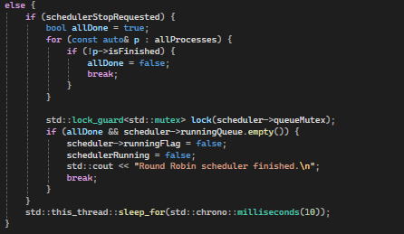
Scheduler implementation - Round Robin
simulates the time slice if the process is not done it will requeue it again
waits for all cores to finish before shutting down and detaches the threads
---------------------------------------------------------------------------------------------------------------------------------
checks for exit condition which will only stop if all processes are done. therefor setting the flag to stop
16

Slide 17
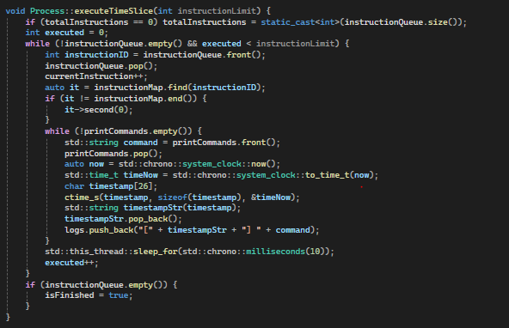
Scheduler implementation - Round Robin
This is part of the round robin implementation that does the instructions, it executes up to the instructionLimit from the process’s queue. Each instruction being represented by a numeric ID mapped from the instruction map explained earlier. After each instruction it will check for the output adding a timestamp log and waiting 10ms to simulate instruction execution time. if all instructions are completed it will mark the process as finished
17

Slide 18

Search
Thank you
RIZZA CHAN JERIMAYA FLORES HANEUL KIM JUSTIN SACDALAN
x
S22 S13 S22 S22

